Slide 1
Mid-Sprint Review 10
The Brewing Game
(Mash It!)
2nd April 2026
Gracjan Blazejowski
Bruce Gray
Marta Grazia
Sergio Eneide
Aaron Stevens

Slide 2
Sprint work
Playtesting notes into reports
Created tickets to address issues/feedback
Red Amber Green (RAG) Analysis for ticket priority
Sprint planning tackling most urgent (Red) tickets
Marta G

Slide 3


Playtesting reports
Transcribed notes into reports to describe how the session went
  User Experience
  User Interface
  Game Loop
  General Feedback
Marta G

Slide 4
Key findings
  Recurring issues
    Settings bug appeared on every session
    Float switch function initially unclear
  What worked well
    Shop used intuitively
    Optimal water level discovery
    UI
  Other notable feedback
    Mash tuns not consistently interacted with
    Win condition not remembered
    Per-brew score unclear
Bruce G

Slide 5
RAG Analysis
Balance between SRS and unwanted behaviour
Team effort to identify priorities
Led to create tickets for the sprint
Marta G

Slide 6
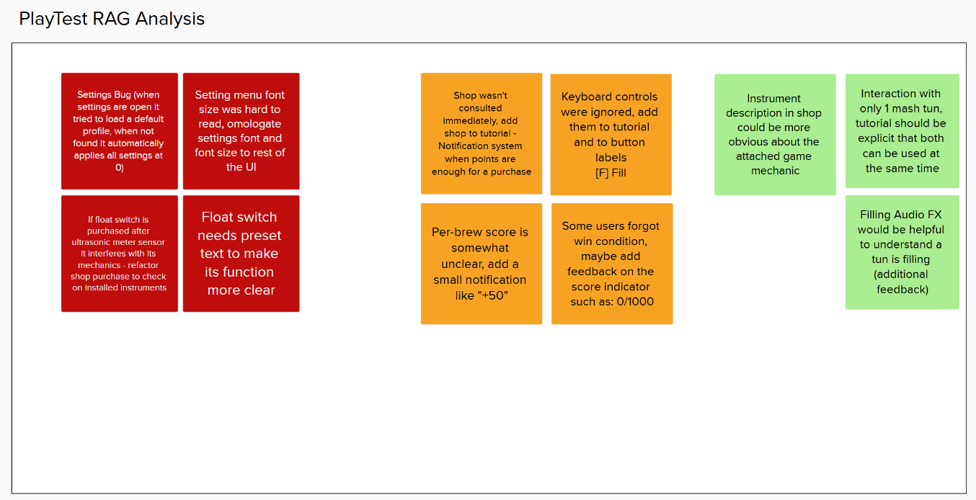
RAG Analysis
Marta G

Slide 7
This sprint’s epics
Fixing the Settings bug
Fixing Float Switch UI
Fixing Float Switch behaviour when purchased after Ultrasonic Flow Meter
Marta G

Slide 8
Thank you!
The Brewing Game’s Team

